Slide 1
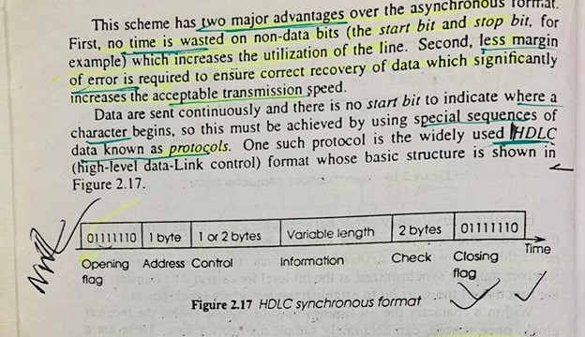
HDLC

Slide 2
………
HDLC is a bit - oriented protocol where each frame contains up to six fields. The structure varies according to the type of frame. The fields of a HDLC frame are −
Flag − It is an 8-bit sequence that marks the beginning and the end of the frame. The bit pattern of the flag is 01111110.
Address − It contains the address of the receiver. If the frame is sent by the primary station, it contains the address(es) of the secondary station(s). If it is sent by the secondary station, it contains the address of the primary station. The address field may be from 1 byte to several bytes.
Control − It is 1 or 2 bytes containing flow and error control information.
Payload − This carries the data from the network layer. Its length may vary from one network to another.
FCS − It is a 2 byte or 4 bytes frame check sequence for error detection.

Slide 3
Bit Stuffing
Dfination
Bit stuffing is the process of inserting noninformation bits into data to break up bitpatterns to affect the synchronous transmission of information. It is widely used innetwork and communication protocols, in which bit stuffing is a required part of the transmission process.

Slide 4
Bit Stuffing(Cont..)
Each frame begins and ends with a special bit pattern called a flag byte [01111110]. {Note this is 7E in hex}.
Whenever sender data link layer encounters five consecutive ones in the data stream, it automatically stuffs a 0 bit into the outgoing stream.
When the receiver sees five consecutive incoming ones, it automatically destuffs the 0 bit before sending the data to the network layer.

Slide 5
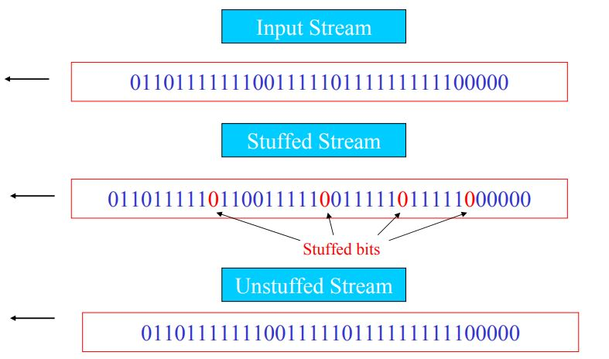
Bit Stuffing (Cont..)

